Slide 1
WEB HOSTING
R Project on:

Slide 2
Web Hosting
Web hosting is the service that makes your website available to be viewed by others on the internet. A web host provider space on its server, so that other computers around the world can access your website by means of a network or modem.
There are thousands of web hosting services available today, ranging from free services with limited options to expensive, specialized business web hosting services.

Slide 3
Domain Name Server (DNS)
Each computer on the Internet is assigned a unique address, called an IP address. A typical IP address looks like this: 199.123.456.7. It is very difficult to keep in mind the IP addresses of all the websites we visit daily.
Words are easier to remember than strings of numbers. This is where domain names come into the picture. When you visit a website, all you need to know is its URL.

Slide 4
Host Provider
A web host, or web hosting service provider, is a business that provides the technologies and services needed for the website or webpage to be viewed in the Internet.
Websites are hosted, or stored, on special computers called servers. If you do not have a domain, the hosting companies will help you purchase one.

Slide 5
Some facts about Web Hosting
Support can be a very broad term in web hosting. Normally, a provider handles hardware needs, server administration, patching, connection to the Internet, and general maintenance of systems. The site owner normally decides what technologies are used: PHP based, ASP.NET, Java, the database solution, along with any third-party technical solutions.

Slide 6
It has been seen that Time on Site of a website decides it’s marketing. For example:- 70.72% of blogs in India uses Wordpress as platform as DNS service and CMT and time on site is 80 seconds

Slide 7
Objectives
On which web technology will the website be develop on
Acceptance Changes in web development technologies
Websites using Hosted Solution technologies
On which web technology will the website be hosted on
Content generating by Users – Decision Making

Slide 8
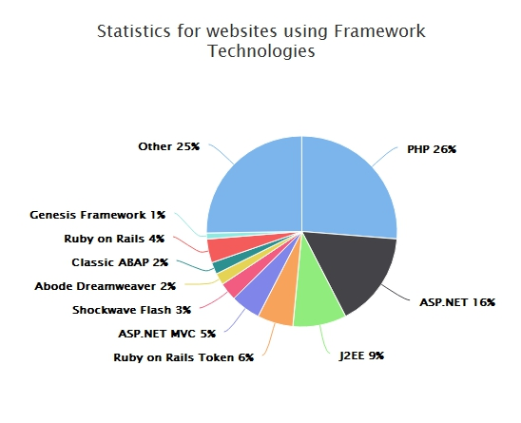
Websites using Framework

Slide 9
The Code used for the same is:
library(highcharter)
data1=read.csv("Framework.csv")
lang=data1$language
print(lang)
per=data1$percentage
print(per)
df=data.frame(lang,per)
print(df)
hc=hchart(df,"pie",hcaes(x=lang,y=per),name="FrameworkPercentage",colorByPoint=TRUE)%>%
hc_title(text="Statistics for websites using Framework Technologies")
print(hc)

Slide 10
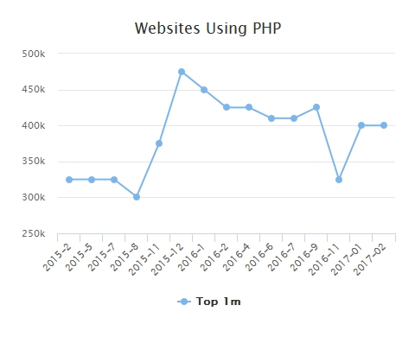
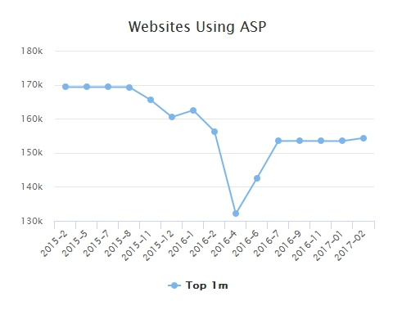
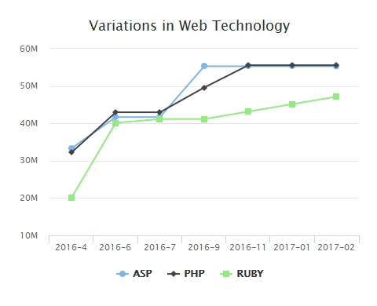
ASP, PHP, Ruby on Rails

Slide 11
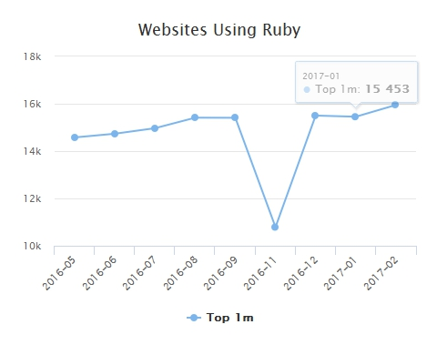
Acceptance change in technology

Slide 12
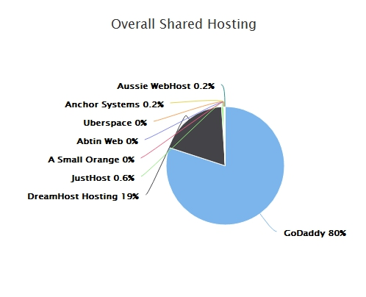
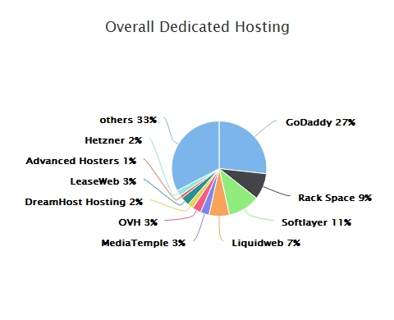
Shared Hosting - In a shared hosting environment, you’re and other website owners shared one server. This includes sharing the physical server and the software applications within the server.
Dedicated Hosting - In a dedicated hosting environment, you have the entire web server to yourself. This allows for faster performance, as you have all the server’s resources entirely, without sharing with other website owners.

Slide 13
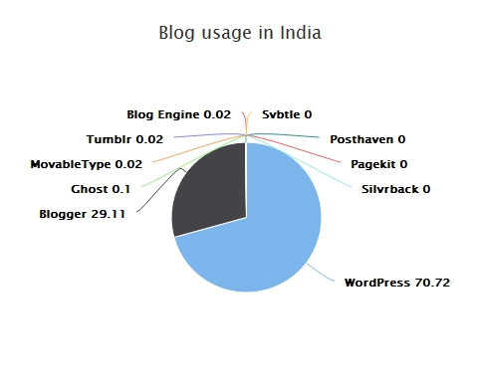

Slide 14
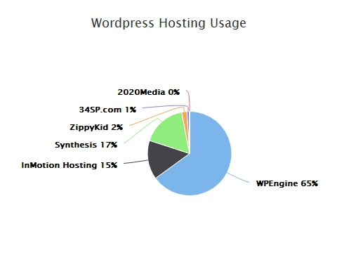

Slide 15
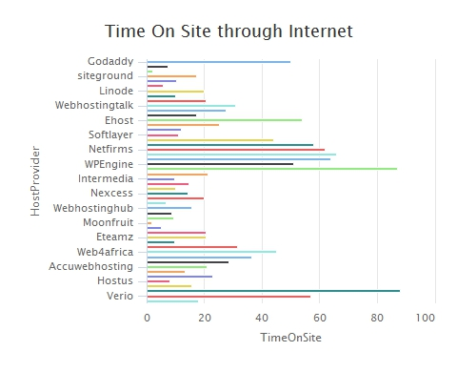
Time on site Time on site is a type of visitor report that provides data on the amount of time (in minutes or seconds) visitors have spent on your website.

Slide 16
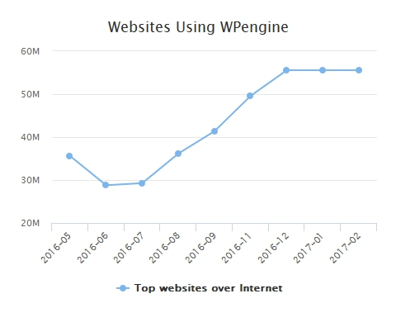
WP Engine is a leading web host in the managed WordPress host category

Slide 17
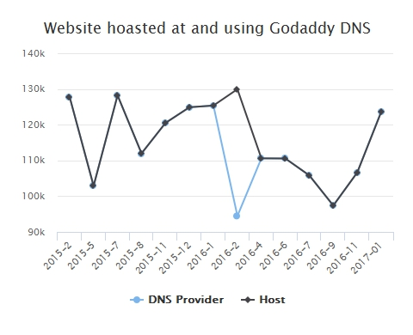
GoDaddy is an American publicly traded Internet domain registrar and web hosting company. As of December 2014, GoDaddy served approximately 13 million customers and had 4,908 employees worldwide.

Slide 18
Thank you

